Slide 1
Comprehensive Survey on Transfer Learning
Abnormal Distribution
Eduardo Peynetti, Jessica Wijaya, Rohit Beri, Stuart Neilson

Slide 2
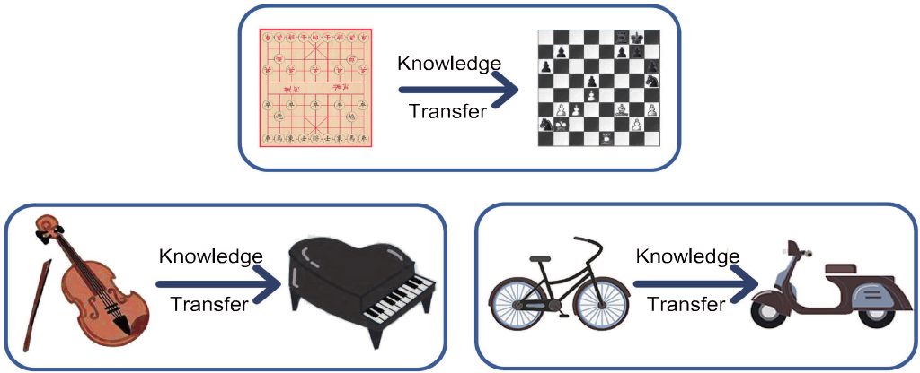
Introduction
Learning to transfer is the result of the generalization of experience
There needs to be a connection between two learning activities
Negative Transfer:
no positive impact on new task
no relevance between source vs. target domains and the learner’s capacity to find transferable knowledge across domains
target learner is negatively affected by the transferred knowledge
Example: learning to bike vs play piano, leaning Spanish and French
Notes:
Negative Transfer
Transfer learning (TL) doesn’t always bring positive impact on new tasks
Learning to ride bicycle cannot help us learn piano faster
Negative Transfer depend on relevance between source and target domains and the learner’s capacity to find the transferable and beneficial parts of the knowledge across the domains
Learning Spanish can make it difficult to learn French though the languages share a lot in common, as previous learning interferes with learning word formation, usage, pronunciation, etc. in French.

Slide 3
Introduction
Homogenous Transfer:
Domains are in the same feature space
Difference is only in marginal distributions
only need domain adaptation e.g. sample selection bias or covariate shift
Heterogenous Transfer:
Domains have different feature space
require feature space adaptation in addition to distribution adaptation
Notes:
Homogeneous Transfer
This paper focused on Homogeneous Transfer Learning
Domains are in the same feature space
Differ only in marginal distributions - dealt by correcting sample selection bias or covariate shift.
This assumption doesn’t hold in some cases, i.e. word may have different meaning in different domains i.e. context feature bias – Adapt conditional distributions
Heterogeneous Transfer
Knowledge transfer where domains have different feature space
Requires feature space adaptation in addition to distribution adaptation
More complicated
Not a focus for this paper
Also not covered are Reinforcement Transfer Learning, Lifelong Transfer Learning & Online Transfer Learning

Slide 4
Related Areas
Semi-Supervised Learning (SSL)
Combines abundant unlabeled instances with a limited number of labeled instances to train a learner
Relaxes the dependence on labeled instances thereby reducing labeling costs
Both instances are drawn from same distribution
In contrasts, the distributions of source and target domains are different in TL
Key assumptions of smoothness, cluster, and manifold hold both in case of semi-supervised and transfer learning
Many a times TL absorbs the technology of SSL
Notes:
Semi-Supervised Learning (SSL)
Combines abundant un-labeled with a limited number of labeled instances to train a learner
Relaxes the dependence on labeled instances thereby reducing labeling costs
Both instances are drawn from same distribution
In contrasts, the distributions of source and target domains are different in Transfer Learning
Key assumptions of smoothness, cluster, and manifold hold both in case of semi-supervised and transfer learning
Many a times TL absorbs the technology of SSL
Multi-View Learning (MVL)
MVL focuses on ML for multi-view data – Object is described from multiple views
Example: Video Object with image signal and audio signal
Learning can be improved by considering information from all the available views
Strategies include – Subspace Learning, Multi-kernel learning, and co-training
Approaches are also adopted in TL – Zhang et al. proposed a multi-view TL framework which imposes the consistency among multiple views
Yang and Gao – Multi-view information across different domains for knowledge transfer
Feuz and Cook – Multi-view TL for activity learning: Knowledge transfer between heterogenous sensor platform
Multi-Task Learning (MTL)
Jointly learn a group of related tasks
Reinforces each task by taking advantage of interconnections
Considers inter-task relevance and inter-task difference – enhances generalization
MTL vs TL: MTL pays equal attention to each task; TL pays more attention to Target task
Zhang et al. employs MTL and TL for biological image analysis
Liu et al. proposes a framework for human-action recognition based on MTL and TL

Slide 5
Related Areas
Multi-View Learning (MVL)
MVL focuses on ML for multi-view data – Object is described from multiple views
Example: Video Object with image signal and audio signal
Learning can be improved by considering information from all the available views
Strategies include – Subspace Learning, Multi-kernel learning, and co-training
Approaches are also adopted in TL – Zhang et al. proposed a multi-view TL framework which imposes the consistency among multiple views
Yang and Gao – Multi-view information across different domains for knowledge transfer
Feuz and Cook – Multi-view TL for activity learning: Knowledge transfer between heterogeneous sensor platform
Notes:
Semi-Supervised Learning (SSL)
Combines abundant un-labeled with a limited number of labeled instances to train a learner
Relaxes the dependence on labeled instances thereby reducing labeling costs
Both instances are drawn from same distribution
In contrasts, the distributions of source and target domains are different in Transfer Learning
Key assumptions of smoothness, cluster, and manifold hold both in case of semi-supervised and transfer learning
Many a times TL absorbs the technology of SSL
Multi-View Learning (MVL)
MVL focuses on ML for multi-view data – Object is described from multiple views
Example: Video Object with image signal and audio signal
Learning can be improved by considering information from all the available views
Strategies include – Subspace Learning, Multi-kernel learning, and co-training
Approaches are also adopted in TL – Zhang et al. proposed a multi-view TL framework which imposes the consistency among multiple views
Yang and Gao – Multi-view information across different domains for knowledge transfer
Feuz and Cook – Multi-view TL for activity learning: Knowledge transfer between heterogenous sensor platform
Multi-Task Learning (MTL)
Jointly learn a group of related tasks
Reinforces each task by taking advantage of interconnections
Considers inter-task relevance and inter-task difference – enhances generalization
MTL vs TL: MTL pays equal attention to each task; TL pays more attention to Target task
Zhang et al. employs MTL and TL for biological image analysis
Liu et al. proposes a framework for human-action recognition based on MTL and TL

Slide 6
Related Areas
Multi-Task Learning (MTL)
Jointly learn a group of related tasks
Reinforces each task by taking advantage of interconnections
Considers inter-task relevance and inter-task difference – enhances generalization
MTL vs TL: MTL pays equal attention to each task; TL pays more attention to Target task
Zhang et al. employs MTL and TL for biological image analysis
Liu et al. proposes a framework for human-action recognition based on MTL and TL
Notes:
Semi-Supervised Learning (SSL)
Combines abundant un-labeled with a limited number of labeled instances to train a learner
Relaxes the dependence on labeled instances thereby reducing labeling costs
Both instances are drawn from same distribution
In contrasts, the distributions of source and target domains are different in Transfer Learning
Key assumptions of smoothness, cluster, and manifold hold both in case of semi-supervised and transfer learning
Many a times TL absorbs the technology of SSL
Multi-View Learning (MVL)
MVL focuses on ML for multi-view data – Object is described from multiple views
Example: Video Object with image signal and audio signal
Learning can be improved by considering information from all the available views
Strategies include – Subspace Learning, Multi-kernel learning, and co-training
Approaches are also adopted in TL – Zhang et al. proposed a multi-view TL framework which imposes the consistency among multiple views
Yang and Gao – Multi-view information across different domains for knowledge transfer
Feuz and Cook – Multi-view TL for activity learning: Knowledge transfer between heterogenous sensor platform
Multi-Task Learning (MTL)
Jointly learn a group of related tasks
Reinforces each task by taking advantage of interconnections
Considers inter-task relevance and inter-task difference – enhances generalization
MTL vs TL: MTL pays equal attention to each task; TL pays more attention to Target task
Zhang et al. employs MTL and TL for biological image analysis
Liu et al. proposes a framework for human-action recognition based on MTL and TL

Slide 7
Transfer Learning Overview
Definitions:
Domain: comprises of feature space X and a marginal distribution P(X)
Task: consists of label space Y and a decision function f to be learned from the data
Transfer Learning will utilize knowledge implied in source domain to improve performance of the learned decision function f^{T} on the target domain
Domain Adaptation: process of adapting 1 (or more) source domains to transfer knowledge and improve the performance of the target learner
Notes:
Definitions
Domain (D): comprises of feature space X and a marginal distribution P(X)
Task (T): consists of label space Y and a decision function f to be learned from the data
Transfer Learning (TL): Utilized knowledge implied in source domain to improve performance of the learned decision function f^{T} on the target domain
Domain Adaptation: Process of adapting one or more source domains to transfer knowledge and improve the performance of the target learner

Slide 8
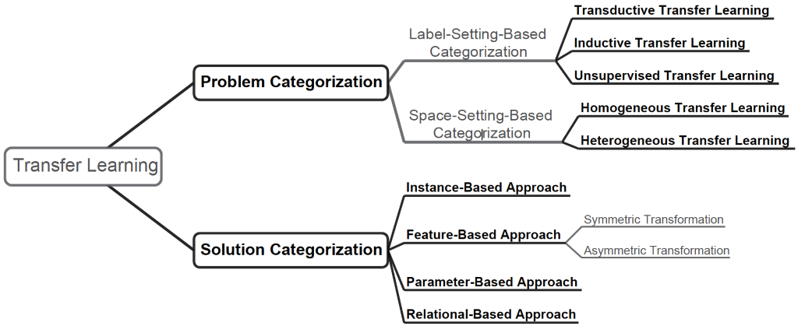
Transfer Learning Categorization
Notes:
Problem Categories
Based on Label Information
Transductive TL – Only source domain has label information
Inductive TL – Both source and target domain have label information
Unsupervised TL – Neither source nor target domain have label information
Based on Feature Space and Label Space
Homogeneous TL – Both Feature Space and Label space of source and target domains are similar
Heterogenous TL – Either Feature Space or Label Space or both not similar for source and target domains
Solution Categories
Instance Based
Instance weighting strategy
Feature Based
Transforms the original features to create new feature representation
Symmetric Transformation – Attempts to find common feature latent space and then transform both the source and the target
Asymmetric Transformation – Transforms source features to match target ones
Parameter Based
Transfer of knowledge at model/parameter level
Relational Based
Focus on problems in relational domain
Transfer of logical relationship or rules learned
This survey does not cover Relational-based approaches

Slide 9
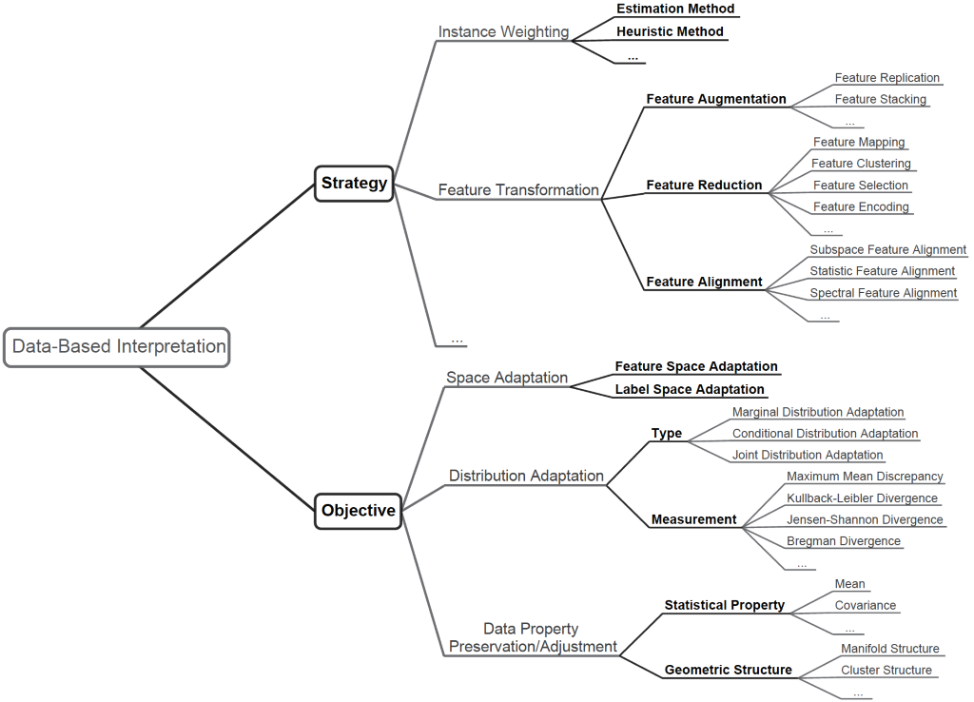
Data Based Interpretation
Notes:
In this survey, we focus more on homogeneous transfer learning, and the main objective in this scenario is to reduce the distribution difference between the source-domain and the target-domain instances.
Strategies
Instance Weighting
Feature Transformation
Objectives
Space Adaptation – Mostly required in Heterogenous TL – Not a focus for this paper
Distribution Adaptation – Main objective in case of Homogeneous TL: To reduce the distribution difference between the source and the target domain instances
Data Property Preservation/Adjustment – Certain advanced approaches and use cases

Slide 10
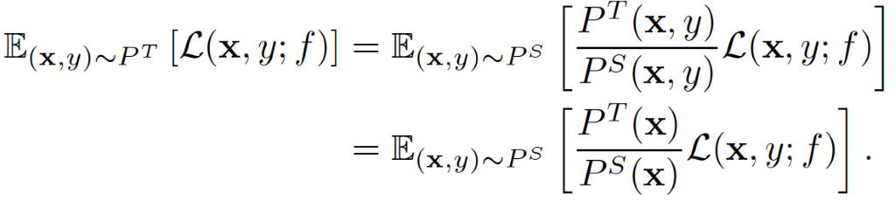
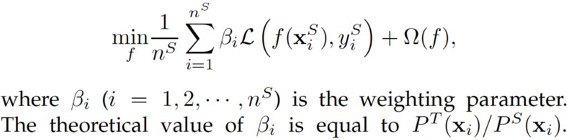
Data Based Interpretation
Instance Weighting Strategy (Overview)
Large number of labeled source and a limited number of target domain instances
Domains differ in only marginal distributions i.e. P^{s}(X) ≠ P^{t}(X) but P^{s}(Y|X) = P^{t}(Y|X)
Adaptation : assigning weights to the source instances in the loss function
Weighting Strategy:
Objective:
Notes:
Instance Weighting Strategy
Large number of labeled source and a limited number of target domain instances are available
Domains differ in only marginal distributions i.e. P^{s}(X) ¹ P^{t}(X) but P^{s}(Y|X) = P^{t}(Y|X)
Adapting the marginal distributions by assigning weights to the source instances in the loss function
Weighting strategy is based on the following equation and objective function:

Slide 11
Data Based Interpretation
Instance Weighting Strategy (Overview)
Large number of labeled source and a limited number of target domain instances
Domains differ in only marginal distributions i.e. P^{s}(X) ≠ P^{t}(X) but P^{s}(Y|X) = P^{t}(Y|X)
Adaptation : assigning weights to the source instances in the loss function
Weighting Strategy:
Objective:
difficult to compute
Notes:
Instance Weighting Strategy
Large number of labeled source and a limited number of target domain instances are available
Domains differ in only marginal distributions i.e. P^{s}(X) ¹ P^{t}(X) but P^{s}(Y|X) = P^{t}(Y|X)
Adapting the marginal distributions by assigning weights to the source instances in the loss function
Weighting strategy is based on the following equation and objective function:

Slide 12
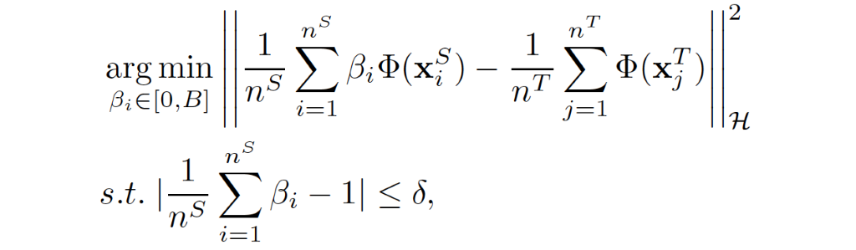
Data Based Interpretation
Instance Weighting Strategy (estimates for β_{i})
Solution #1: Kernel Mean Matching (KMM)
Estimates β_{i}‘s by matching means between the source and target domain instances in a Reproducing Kernel Hilbert Space (RKHS).
δ is a small parameter, and B is a parameter for constraint
Notes:
Kernel Mean Matching
Estimates β_{i}‘s by matching means between the source and target domain instances in a Reproducing Kernel Hilbert Space (RKHS).
δ is a small parameter, and B is a parameter for constraint

Slide 13
Data Based Interpretation
Instance Weighting Strategy (estimates for β_{i})
Solution #2: Kullback-Leibler Importance Estimation Procedure (KLIEP)
Depends on minimizing KL divergence
Incorporates built-in model selection procedure
Notes:
Kullback-Leibler Importance Estimation Procedure (KLIEP): Sugiyama et al.
Depends on minimizing KL divergence
Incorporates built-in model selection procedure

Slide 14
Data Based Interpretation
Instance Weighting Strategy (estimates for β_{i})
Solution #3: 2-Stage Weighting Framework for Multi-Source Domain Adaptation (2SW-MDA)
Step 1: Instance Weighting (similar to KMM)
Step 2: Domain Weighting (weights are assigned to each domain for reducing conditional distribution difference based on smoothness assumption)
Then, source domain instances are reweighted using instance weights and domain weights. The reweighted instances along with labeled target-domain instances are used to train the classifier
Notes:
2-Stage Weighting Framework for Multi-Source Domain Adaptation (2SW-MDA): Sun et al.
Stage 1: Instance Weighting – similar to KMM
Stage 2: Domain Weighting – Weights are assigned to each domain for reducing conditional distribution difference based on smoothness assumption
Source domain instances are reweighted using instance weights and domain weights
Reweighted instances along with label target domain instances are used to train the classifier

Slide 15
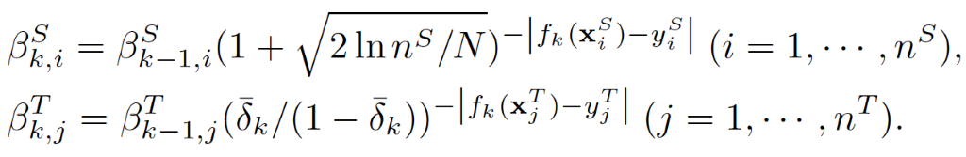
Data Based Interpretation
Instance Weighting Strategy (estimates for β_{i})
Solution #4: TrAdaBoost
Adjust weights iteratively:
decrease the weights of the instances that have negative effects on the target learner
Labeled source-domain and labeled target-domain instances are combined to train the weak classifier, but the weighting operations are different for the source-domain and the target-domain instances
Notes:
TrAdaBoost – Bosting for Transfer Learning: Dai et al.
Adjust weights iteratively – extends AdaBoost to transfer learning scenario
Mechanism to decrease weights on instances that have negative effects on the target learner
The labeled source and target domains are combined to train the weak learner, but the weighting operations are different for the source-domain and the target-domain instances
Final classifier combines and ensembles half of newly minted weak classifier through voting scheme
Different weighting operations for source and target domains

Slide 16
Data Based Interpretation
Instance Weighting Strategy (estimates for β_{i})
Other solutions:
TaskTrAdaBoost – Parameter based algorithm
General Weighting Framework (Heuristic Method) by Jiang & Zhai:
Minimize cross-entropy loss of:
Labeled Target Instance,
Unlabeled Target Instance, and
Labeled Source Instance

Slide 17
Data Based Interpretation
Feature Transformation Strategy (Overview)
Example: cross domain text classification problem
Find latent features (e.g. latent topics) through transformation use them as bridge for knowledge transfer
Objective of constructing latent space:
minimizing marginal and conditional distribution difference (primary objective)
preserving properties/potential structures of the data,
finding correspondence between features
Operations of feature transformation:
Feature Augmentation (Feature Replication, Stacking)
Feature Reduction (Feature Mapping, Clustering, Selection, Encoding)
Feature Alignment
Notes:
Feature Transformation Strategy
Often adopted in feature-based approaches and consists of several operations
Example – cross domain text classification problem
Find latent features through transformation use them as bridge for knowledge transfer
Objective of constructing latent space include:
minimizing marginal and conditional distribution difference (primary objective),
preserving properties/potential structures of the data,
finding correspondence between features
Three types of feature transformation:
Feature Augmentation
Feature Replication
Feature Stacking
Feature Reduction
Feature Mapping
Feature Clustering
Feature Selection
Feature Encoding
Feature Alignment

Slide 18
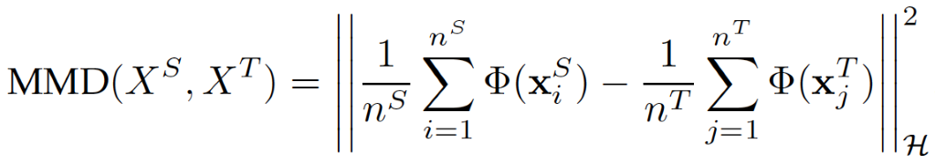
Data Based Interpretation
Feature Transformation Strategy (Metric)
To measure distribution difference/similarity:
Maximum Mean Discrepancy (MMD)
Kullback-Leibler Divergence
Jensen-Shannon Divergence
Bregman Divergence
Hisbert-Schmidt Independence Criterion
And many others
Notes:
Distribution Difference Metric
How to measure distribution difference or similarity is an important issue - Commonly used metrics:
Maximum Mean Discrepancy (MMD): Widely used in Transfer Learning
Kullback-Leibler Divergence
Jensen-Shannon Divergence
Bregman Divergence
Hisbert-Schmidt Independence Criterion
Others:
Wasserstien Distance, Central Moment Discrepancy
Munti-Kernel Maximum Mean Discrepancy (MK-MMD) by Gretton et al.
Weighted version of MMD by Yan et al. - attempts to address class weight bias

Slide 19
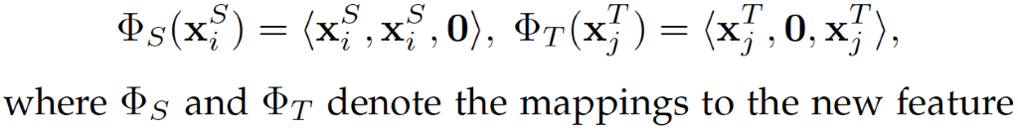
Data Based Interpretation
Feature Augmentation
Feature Replication - Feature Augmentation Method (FAM)
Feature space augmented 3x: general, source-specific, & target-specific features
For transformed source-domain, target-specific features are set to 0 & vice-versa
Then, the final classifier is trained on transformed labeled instances
Feature Stacking
Problem with FAM: Padding 0 vectors and directly replicating features is less effective when source and target domains have different feature representations
Heterogeneous Feature Augmentation (HFA) maps original features into a common features space and then performs a feature stacking operation
Notes:
Feature Augmentation
Widely used, particularly in symmetric feature-based approaches
Feature Replication: Feature Augmentation Method (FAM) by Daumé – a simple feature replication
Feature space augmented to three times its size – general features, source-specific features, target-specific features
For transformed source-domain, target-specific features are set to Zero & vice-versa
Final classifier is trained on transformed labeled instances
Generalizes well to multi-source scenarios thought at the cost of redundancy
Utilizes unlabeled instances to further facilitate the knowledge transfer
Feature Stacking: FAM may not work well with Heterogenous TL tasks
Padding zero vectors and directly replicating features as in FAM less is less effective when source and target domains have different feature representations
Heterogenous Feature Augmentation (HFA) by Li et al. maps original features into a common features space and then performs a feature stacking operation

Slide 20
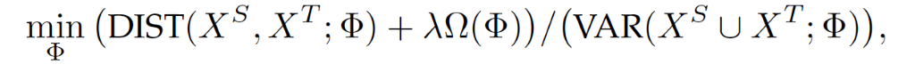
Data Based Interpretation
Feature Reduction (with Feature Mapping)
Traditional ML (PCA, kernel PCA, etc. ) focus on data variance, not distribution variances
Objective: find mapping for feature extraction when there is little difference in conditional distribution
Find Φ(·) that minimizes the numerator (distance) & maximizes denominator (variance)
How?
First optimize the objective of the numerator and then denominator
Notes:
Feature Mapping
In traditional ML, there are many feasible mapping methods of feature extraction like PCA, Kernel PCA, etc.
Focus on data variance
Not on distribution difference
A simple objective function can be used to find mapping for feature extraction when there is little difference in conditional distribution
Finding explicit formulation of Φ(·) is non-trivial – we need to minimize the numerator (Distance) while maximizing the denominator (Variance)
One way to deal with this challenge is to first optimize the objective of the numerator and then realize the objective of the denominator. Three main pathways to deal with problem:
Mapping Learning + Feature Extraction
Find high-dimensional feature space by solving kernel matrix or a learning transformation matrix, and
Then use PCA, etc. to form low-dimensional representation
Mapping Construction + Mapping Learning
Find high-dimensional feature space by solving kernel matrix learning problem
Then learn transformation matrix to form low-dimensional representation
Direct Low-dimensional Mapping Learning
Usually difficult to directly find low-dimensional mapping. However, it is solvable in certain conditions – e.g. when mapping is restricted to linear.

Slide 21
Data Based Interpretation
Feature Reduction (with Feature Mapping)
Goal: Find Φ(·) that minimizes the numerator (distance) & maximizes denominator (variance). Three main pathways to deal with problem:
Mapping Learning + Feature Extraction
Find high-dimensional feature space by solving kernel matrix or a learning transformation matrix. Then, use PCA to form low-dimensional representation
Mapping Construction + Mapping Learning
Find high-dimensional feature space by solving kernel matrix learning problem
Then learn transformation matrix to form low-dimensional representation
Direct Low-dimensional Mapping Learning
solvable in certain conditions – e.g. when mapping is restricted to linear.
Notes:
Feature Mapping
In traditional ML, there are many feasible mapping methods of feature extraction like PCA, Kernel PCA, etc.
Focus on data variance
Not on distribution difference
A simple objective function can be used to find mapping for feature extraction when there is little difference in conditional distribution
Finding explicit formulation of Φ(·) is non-trivial – we need to minimize the numerator (Distance) while maximizing the denominator (Variance)
One way to deal with this challenge is to first optimize the objective of the numerator and then realize the objective of the denominator. Three main pathways to deal with problem:
Mapping Learning + Feature Extraction
Find high-dimensional feature space by solving kernel matrix or a learning transformation matrix, and
Then use PCA, etc. to form low-dimensional representation
Mapping Construction + Mapping Learning
Find high-dimensional feature space by solving kernel matrix learning problem
Then learn transformation matrix to form low-dimensional representation
Direct Low-dimensional Mapping Learning
Usually difficult to directly find low-dimensional mapping. However, it is solvable in certain conditions – e.g. when mapping is restricted to linear.

Slide 22
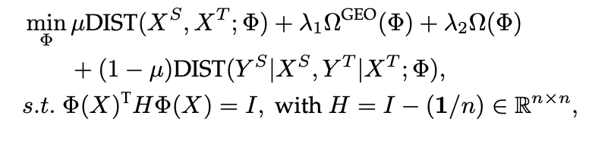
Data Based Interpretation
Feature Reduction (with Feature Mapping)
Other approach
Match the conditional distribution and preserve the structures of the data
Modified objective function (with additional terms and constraints):
Mapping techniques:
Maximum Mean Discrepancy Embedding (MMDE)
Transfer Component Analysis (TCA)
etc.
Notes:
Other approach: Matching conditional distribution and preserve the structures of the data. The above objective function needs to be modified - requires additional terms and constraints.
More advanced mapping techniques are required in such case.
Maximum Mean Discrepancy Embedding (MMDE)
Transfer Component Analysis (TCA)
Joint Distribution Adaptation (JDA)
Balanced Distribution Adaptation (BDA) and Weighted BDA (WBDA)
Adaptation Regularization Based Transfer Learning (ARTL)
Domain Transfer Multiple Kernel Learning (DTMKL)

Slide 23
Data Based Interpretation
Feature Reduction (with Feature Clustering)
Reduce the feature by finding more abstract representations of original features
Co-Clustering Based Classification (CoCC)
Source and target document-to-word matrix is co-clustered
Minimize the joint loss in mutual-information with 2-steps single iteration:
Document Clustering – reorder document-to-word matrix for target document
Word Clustering – adjust word clusters to minimize joint mutual-information loss
Notes:
Featuring Clustering
Find more abstract representation of original features – different from mapping-based extraction
Example: reducing features using co-clustering – simultaneously clusters rows and columns using information theory
Co-Clustering Based Classification (CoCC) by Dai et al. uses co-clustering for document classification
Co-clustering as a technique to transfer knowledge – source and target document-to-word matrix is co-clustered
Minimize the joint loss in mutual-information – iterative process with 2-step single iteration
Document Clustering – reorder document-to-word matrix for target document
Word Clustering – adjust word clusters to minimize joint mutual-information loss
Self-Taught Cluster (STC) – unsupervised co-clustering proposed by Dai et al.
Does not need label information but two domains should share the same feature clusters in their common feature space
Each iteration involves 2-steps minimizing mutual-information loss:
Instance Clustering: Clustering updated to minimize respective loss
Feature Clustering: Feature clusters are updated to minimize the joint loss
Concept-based Transfer Learning Approaches
Latent Semantic Analysis (LSA) – maps document-to-word matrix to latent space using SVD
SVD can remove the irrelevant information and the noise
Probabilistic LSA (PLSA) – Constructs a Bayesian network & uses EM to estimate parameters
Latent variable z, reflects the concept and associates document d with the word w
Dual-PLSA – 2 latent variables z^{d} & z^{w} reflecting concepts behind documents and words
Topic-Bridged PLSA (TPSLA) – Assumes source and target instances share the same mixing concepts of the words
Collaborative Dual-PLSA (CD-PLSA) – For multi-domain text classification
Homogeneous-Identical-Distinct-Concept-Model (HIDC) – Extension of Dual-PLSA
Composed of three generative models – identical-concept, homogeneous-concept, and distinct-concept models and used EM-algo to estimate parameters

Slide 24
Data Based Interpretation
Feature Reduction (with Feature Clustering)
Reduce the feature by finding more abstract representations of original features
Self-Taught Cluster (STC) - unsupervised
Does not need label information but the domains should share the same feature clusters in their common feature space
Minimizes mutual-information loss with 2 steps/iteration:
Instance Clustering: clustering updated to minimize respective loss
Feature Clustering: feature clusters are updated to minimize the joint loss
Notes:
Featuring Clustering
Find more abstract representation of original features – different from mapping-based extraction
Example: reducing features using co-clustering – simultaneously clusters rows and columns using information theory
Co-Clustering Based Classification (CoCC) by Dai et al. uses co-clustering for document classification
Co-clustering as a technique to transfer knowledge – source and target document-to-word matrix is co-clustered
Minimize the joint loss in mutual-information – iterative process with 2-step single iteration
Document Clustering – reorder document-to-word matrix for target document
Word Clustering – adjust word clusters to minimize joint mutual-information loss
Self-Taught Cluster (STC) – unsupervised co-clustering proposed by Dai et al.
Does not need label information but two domains should share the same feature clusters in their common feature space
Each iteration involves 2-steps minimizing mutual-information loss:
Instance Clustering: Clustering updated to minimize respective loss
Feature Clustering: Feature clusters are updated to minimize the joint loss
Concept-based Transfer Learning Approaches
Latent Semantic Analysis (LSA) – maps document-to-word matrix to latent space using SVD
SVD can remove the irrelevant information and the noise
Probabilistic LSA (PLSA) – Constructs a Bayesian network & uses EM to estimate parameters
Latent variable z, reflects the concept and associates document d with the word w
Dual-PLSA – 2 latent variables z^{d} & z^{w} reflecting concepts behind documents and words
Topic-Bridged PLSA (TPSLA) – Assumes source and target instances share the same mixing concepts of the words
Collaborative Dual-PLSA (CD-PLSA) – For multi-domain text classification
Homogeneous-Identical-Distinct-Concept-Model (HIDC) – Extension of Dual-PLSA
Composed of three generative models – identical-concept, homogeneous-concept, and distinct-concept models and used EM-algo to estimate parameters

Slide 25
Data Based Interpretation
Feature Reduction (with Feature Clustering)
Reduce the feature by finding more abstract representations of original features
Approaches for Concept-based Transfer Learning Approaches
Latent Semantic Analysis (LSA):
maps document-to-word matrix to latent space using SVD
Probabilistic LSA (PLSA):
Constructs a Bayesian network & uses EM to estimate parameters
Latent variable z, reflects the concept and associates document d with the word w
Dual-PLSA:
2 latent variables z^{d} & z^{w} reflecting concepts behind documents and words
Notes:
Featuring Clustering
Find more abstract representation of original features – different from mapping-based extraction
Example: reducing features using co-clustering – simultaneously clusters rows and columns using information theory
Co-Clustering Based Classification (CoCC) by Dai et al. uses co-clustering for document classification
Co-clustering as a technique to transfer knowledge – source and target document-to-word matrix is co-clustered
Minimize the joint loss in mutual-information – iterative process with 2-step single iteration
Document Clustering – reorder document-to-word matrix for target document
Word Clustering – adjust word clusters to minimize joint mutual-information loss
Self-Taught Cluster (STC) – unsupervised co-clustering proposed by Dai et al.
Does not need label information but two domains should share the same feature clusters in their common feature space
Each iteration involves 2-steps minimizing mutual-information loss:
Instance Clustering: Clustering updated to minimize respective loss
Feature Clustering: Feature clusters are updated to minimize the joint loss
Concept-based Transfer Learning Approaches
Latent Semantic Analysis (LSA) – maps document-to-word matrix to latent space using SVD
SVD can remove the irrelevant information and the noise
Probabilistic LSA (PLSA) – Constructs a Bayesian network & uses EM to estimate parameters
Latent variable z, reflects the concept and associates document d with the word w
Dual-PLSA – 2 latent variables z^{d} & z^{w} reflecting concepts behind documents and words
Topic-Bridged PLSA (TPSLA) – Assumes source and target instances share the same mixing concepts of the words
Collaborative Dual-PLSA (CD-PLSA) – For multi-domain text classification
Homogeneous-Identical-Distinct-Concept-Model (HIDC) – Extension of Dual-PLSA
Composed of three generative models – identical-concept, homogeneous-concept, and distinct-concept models and used EM-algo to estimate parameters

Slide 26
Data Based Interpretation
Feature Reduction (with Feature Clustering)
Reduce the feature by finding more abstract representations of original features
Approaches for Concept-based Transfer Learning Approaches
Topic-Bridged PLSA (TPSLA)
assumes source and target instances share the same mixing concepts of the words
Collaborative Dual-PLSA (CD-PLSA)
For multi-domain text classification
Homogeneous-Identical-Distinct-Concept-Model (HIDC)
Extension of Dual-PLSA
Composed of three generative models (identical-concept, homogeneous-concept, and distinct-concept models) and used EM-algo to estimate parameters
Notes:
Featuring Clustering
Find more abstract representation of original features – different from mapping-based extraction
Example: reducing features using co-clustering – simultaneously clusters rows and columns using information theory
Co-Clustering Based Classification (CoCC) by Dai et al. uses co-clustering for document classification
Co-clustering as a technique to transfer knowledge – source and target document-to-word matrix is co-clustered
Minimize the joint loss in mutual-information – iterative process with 2-step single iteration
Document Clustering – reorder document-to-word matrix for target document
Word Clustering – adjust word clusters to minimize joint mutual-information loss
Self-Taught Cluster (STC) – unsupervised co-clustering proposed by Dai et al.
Does not need label information but two domains should share the same feature clusters in their common feature space
Each iteration involves 2-steps minimizing mutual-information loss:
Instance Clustering: Clustering updated to minimize respective loss
Feature Clustering: Feature clusters are updated to minimize the joint loss
Concept-based Transfer Learning Approaches
Latent Semantic Analysis (LSA) – maps document-to-word matrix to latent space using SVD
SVD can remove the irrelevant information and the noise
Probabilistic LSA (PLSA) – Constructs a Bayesian network & uses EM to estimate parameters
Latent variable z, reflects the concept and associates document d with the word w
Dual-PLSA – 2 latent variables z^{d} & z^{w} reflecting concepts behind documents and words
Topic-Bridged PLSA (TPSLA) – Assumes source and target instances share the same mixing concepts of the words
Collaborative Dual-PLSA (CD-PLSA) – For multi-domain text classification
Homogeneous-Identical-Distinct-Concept-Model (HIDC) – Extension of Dual-PLSA
Composed of three generative models – identical-concept, homogeneous-concept, and distinct-concept models and used EM-algo to estimate parameters

Slide 27
Data Based Interpretation
Feature Reduction (with Feature Selection)
Reduce the feature by extracting pivot features that behave the same way in different domains. Stability of pivot features helps in serving as bridge for knowledge transfer.
Structural Correspondence Learning (SCL) consists of the following steps:
Feature Selection:
obtain pivot features
Mapping Learning:
find low dimensional latent representation using Structured Learning
Feature Stacking:
construct new feature representation by stacking original features with latent ones
Example: part of speech tagging problem
Notes:
Feature Selection
Feature reduction method to extract pivot features – features that behave in the same way in different domains
Stability of pivot features aid in acting as bridge for transfer of knowledge
Structural Correspondence Learning (SCL) by Blitzer et al.: Consists of the following steps:
Feature Selection – to obtain pivot features
Mapping Learning – find low dimensional latent representation using Structured Learning
Feature Stacking – construct new feature representation by stacking original features with latent ones
Example: Part of speech tagging problem – final classifier is trained in augmented feature space

Slide 28
Data Based Interpretation
Feature Reduction (with Feature Encoding)
Use Autoencoder to produce more abstract representation of the input
Stacked Denoising Autoencoder (SDA):
Denoising autoencoder which can enhance the robustness
Contains randomly corrupting mechanism that adds noise to the input before mapping
Mainly composed of the following steps:
Training Autoencoder
Feature Encoding & Stacking
Learner Training
Challenges: High computational and parameter estimation costs
Notes:
Feature Encoding
Autoencoder are often used for feature encoding to produce more abstract representation of the input
Stacked Denoising Autoencoder (SDA) by Glorot et al.:
Denoising autoencoder which can enhance the robustness
Contains randomly corrupting mechanism that adds noise to the input before mapping
Mainly composed of the following steps:
Autoencoder Training: source and target instances are used to train a stack of denoising autoencoders in a greedy layer by layer way
Feature encoding & Stacking: a new representation is constructed by stacking the encoding output of intermediate layers
Learner Training: The target classifier is trained on the transformed labeled instances
High computational and parameter estimation costs

Slide 29
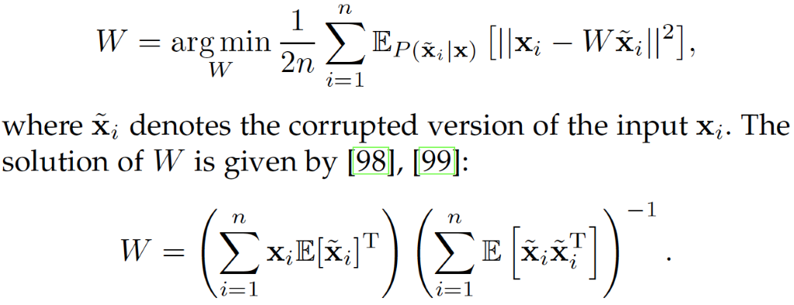
Data Based Interpretation
Feature Reduction (with Feature Encoding)
Suggested Approaches:
Marginalized Stacked Linear Denoising Autoencoder (mSLDA)
Adopts linear autoencoder and marginalizes the randomly corrupting step in a closed form to shorter the training time
Basic architecture: single layer linear autoencoder
Minimizing expected squared reconstruction loss function
Notes:
Marginalized Stacked Linear Denoising Autoencoder (mSLDA) by Chen et al.
adopts linear autoencoder and marginalizes the randomly corrupting step in a closed form to shorter the training time
Linear autoencoder often sufficient when dealing with high-dimensional data
Basic architecture is single layer linear autoencoder
Minimizing expected squared reconstruction loss function

Slide 30
Data Based Interpretation
Feature Alignment
While feature augmentation and feature reduction mainly focus on explicit features, feature alignment focus on implicit features
explicit features can be aligned to generate new representation
implicit features can be aligned to construct a satisfied feature transformation
Implicit Features:
Subspace Features
Static Features
Spectral Features
Notes:
Feature Alignment
In addition to explicit features, feature alignment also focuses on implicit features such as:
Statistic Features
Spectral Features
Example, explicit features can be aligned to generate new representation; implicit features can be aligned to construct a satisfied feature transformation
Typical alignment process, let’s say for subspace features looks like:
Subspace Generation: generate respective subspaces from source and target domains
Subspace Alignment: mapping to align subspaces orthonormal bases is learned
Learner Training: Target learner is trained on transformed instances using projection to aligned bases

Slide 31
Data Based Interpretation
Feature Alignment (Subspace Feature)
Subspace feature alignment process in general:
Subspace Generation: generate respective subspaces from source and target domains
Subspace Alignment: mapping to align subspaces orthonormal bases is learned
Learner Training: Target learner is trained on transformed instances using projection to aligned bases
Notes:
Subspace Alignment (SA) by Fernando et al.:
Subspaces generated using PCA and bases obtained by selecting leading eigenvectors
Transformation matrix W is learned to align subspaces

Slide 32
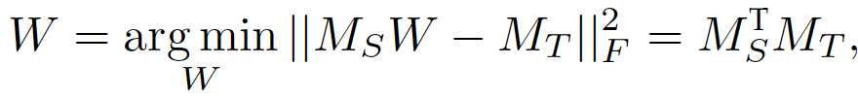
Data Based Interpretation
Feature Alignment
Subspace Alignment (SA)
Subspaces generated using PCA; bases obtained by selecting leading eigenvectors
Transformation matrix W is learned to align subspaces
Subspace Distribution Alignment between Two Subspaces (SDA-TS):
Aligns both subspaces and the distributions
Geodesic Flow Kernel (GFK)
based on Geodesic Flow Subspaces integrates infinite number of subspaces located on geodesic curve from the source to the target subspace
Co-Relation Alignment (CORAL)
constructs transformation matrix by aligning the second-order statistic features i.e. covariance matrices

Slide 33
Data Based Interpretation
Feature Alignment
5. Spectral Feature Alignment (SFA):
Algorithm for sentiment classification based on spectral clustering and feature alignment
SFA generally consists of following 5-steps:
Feature Selection: Select domain independent/pivot features
Similarity Matrix Construction: Construct a bipartite graph
Spectral Feature Alignment: Adapting spectral clustering algorithm
Feature Stacking: Original features and low dimensional features
Learner Training: On final representation using labeled instances
Notes:
Spectral Feature Alignment (SFA) by Pan et al.:
Algorithm for sentiment classification based on spectral clustering and feature alignment
Spectral clustering, based on graph theory, uses eigenvalues of similarity matrix to reduce dimension of the features before clustering
Identify domain-specific and domain-independent words
Aligns domain-specific word features to construct low dimensional representation
SFA generally consists of following 5-steps:
Feature Selection: Select domain independent/pivot features
3-different strategies: Frequency of words, Mutual information between features and labels, and Mutual information between features and domains
Similarity Matrix Construction: Construct a bipartite graph
Each edge is assigned a weight that measure the co-occurrence relationship between domain-specific and domain-independent words
Based on that construct similarity matrix
Spectral Feature Alignment: Adapting spectral clustering algorithm
Align domain-specific features and obtain low-dimensional feature space
Based on eigenvectors of the graph Laplacian
Feature Stacking: Original features and low dimensional features
Stacked to produce final representation
Learner Training: On final representation using labeled instances
Cross-Domain Spectral Clustering (CDSC) by Ling et al. is another spectral transfer learning approach which only uses 3-step approach

Slide 34
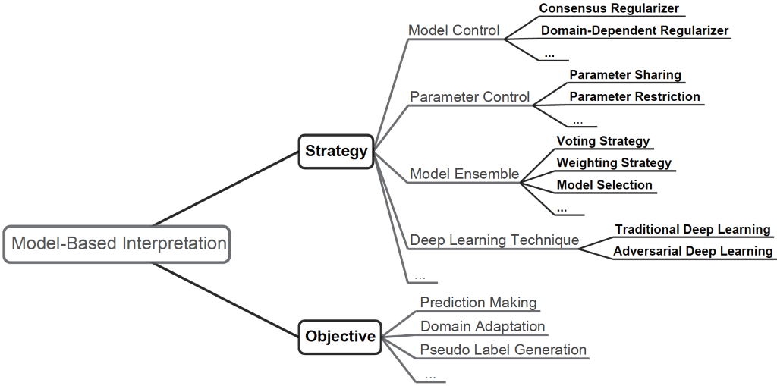
Model Based Interpretation

Slide 35

Model Based Interpretation
Model Control Strategy
Add the model-level regularizers to the learner’s objective function so the knowledge contained in the pre-obtained source models can be transferred into the target model during the training
Domain Adaptation Machine (DAM) - for multi-source transfer learning
Goal: construct a classifier for the target domain with the help of some pre-obtained base classifiers that are respectively trained on multiple source domains
Objective:
Notes:
Model Control Strategy
Add the model-level regularizers to the learner’s objective function so the knowledge contained in the pre-obtained source models can be transferred into the target model during the training
Domain Adaptation Machine (DAM) by Duan et al.:
for multi-source transfer learning
Goal: to construct a robust classifier for the target domain with the help of some pre-obtained base classifiers that are respectively trained on multiple source domains
Objective Function:
the first term = loss function used to minimize the classification error of the labeled target-domain instances
the second term = regularizers, and
the third term is used to control the complexity of the final decision function f^{T}
Special Case of DAM:
Consensus Regularization Framework (CRF) by Luo et al.
Fast-DAM (Domain-dependent Regularizer)
Univer-DAM (Domain-dependent Regularizer + Universum Regularizer)

Slide 36
Model Based Interpretation
Parameter Control Strategy
This strategy focuses on the parameters of models.
Parameter Sharing: directly share the parameters of the source learner to the target learner
Network based parameter sharing:
if we have a neural network for the source task, we can freeze (or say, share) most of its layers and only finetune the last few layers to produce a target network
Matrix factorization-based parameter sharing:
Matrix Tri-Factorization Based Classification Framework (MTrick) by Zhuang et al.
Triplex Transfer Learning (TriTL) by Zhuang et al. (an extension of MTrick)
Notes:
Parameter Control Strategy
focuses on the parameters of models.
For example, in the application of object categorization, the knowledge from known source categories can be transferred into target categories via object attributes such as shape and color
Parameter Sharing
Directly share the parameters of the source learner to the target learner
Network based parameter sharing:
if we have a neural network for the source task, we can freeze (or say, share) most of its layers and only finetune the last few layers to produce a target network
Matrix factorization-based parameter sharing:
Matrix Tri-Factorization Based Classification Framework (MTrick) by Zhuang et al.
Triplex Transfer Learning (TriTL) by Zhuang et al. (an extension of MTrick)

Slide 37
Model Based Interpretation
Parameter Control Strategy
Parameter Restriction
Unlike parameter sharing strategy that enforces the models to share some parameters, parameter restriction strategy only requires the parameters of the source and the target models to be similar
Proposed Approaches:
Single-Model Knowledge Transfer (SMKL) by Tommasi et al.
Multi-Model Knowledge Transfer (MMKL) by Tommasi et al. (extension of SMKL)
Notes:
Parameter Restriction
Different from the parameter sharing strategy that enforces the models share some parameters, parameter restriction strategy only requires the parameters of the source and the target models to be similar
Proposed Approaches:
Single-Model Knowledge Transfer (SMKL) by Tommasi et al.
Multi-Model Knowledge Transfer (MMKL) by Tommasi et al. (extension of SMKL)

Slide 38
Model Based Interpretation
Model Ensemble Strategy
Aims to combine a number of weak classifiers to make the final predictions. Approaches:
TaskTrAdaBoost (extension of TrAdaBoost for multi-source scenarios):
Candidate Classifier Construction
Classifier Selection and Ensemble
Locally Weighted Ensemble (LWE)
focuses on the ensemble process of various learners
these learners could be constructed on different source domains, or be built by performing different learning algorithms on a single source domain
Ensemble Framework of Anchor Adapters (ENCHOR)
Constructs a group of weak learners via using different representations of the instances produced by anchors.
Notes:
Model Ensemble Strategy
This strategy aims to combine a number of weak classifiers to make the final predictions.
For Example, TrAdaBoost and MsTrAdaBoost ensemble the weak classifiers via voting and weighting, respectively.
TaskTrAdaBoost (extension of TrAdaBoost for multi-source scenarios) involve the following 2 steps:
Candidate Classifier Construction:
a group of candidate classifiers are constructed by performing AdaBoost on each source domain.
Classifier Selection and Ensemble
a revised version of AdaBoost is performed on the target domain instances to construct the final classifier.
In each iteration, an optimal candidate classifier which has the lowest classification error on the labeled target-domain instances is picked out and assigned with a weight based on the classification error. Then, the weight of each target-domain instance is updated based on the performance of the selected classifier on the target domain. After the iteration process, the selected classifiers are ensembled to produce the final prediction
Locally Weighted Ensemble (LWE) by Gao et al.:
focuses on the ensemble process of various learners; these learners could be constructed on different source domains, or be built by performing different learning algorithms on a single source domain
a learner is usually assigned with different weights when classifying different target-domain instances, using a graph-based approach to estimate the weights:
Graph Construction
Learner Weighting
Ensemble Framework of Anchor Adapters (ENCHOR)
Constructs a group of weak learners via using different representations of the instances produced by anchors.
Process:
Anchor Selection
Anchor-based Representation Generation
Learner Training and Ensemble

Slide 39
Model Based Interpretation
Deep Learning Strategy
SDA and mSLDA approaches utilize deep learning techniques
2 types of approaches
Traditional Deep Learning (non-adversarial)
Adversarial Deep Learning

Slide 40
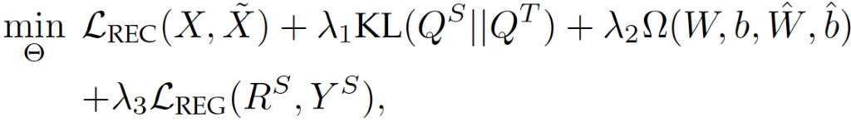
Model Based Interpretation
Traditional Deep Learning
In additional to SDA and mSLDA, there are other reconstruction-based TL approaches:
Transfer Learning with Deep Autoencoders (TLDA)
Adopts 2-autoencoders for the source and target domain (share the parameters and have 2-layers each for encoder and decoder)
Several objectives of TLDA :
Reconstruction error minimization: for decoder output (X)
Distribution Adaptation: for intermediate layer output (Q)
Regression error minimization: for encoder output with labels (R)

Slide 41
Model Based Interpretation
Traditional Deep Learning
Deep Adaptation Network (DAN)
Multi-layer adaptation utilizing multi-kernel technique
Train of thought is similar to Generative Adversarial Networks (GANs)
Deep CORAL (DCORAL) by Sun and Saenko
Extends CORAL for deep domain adaptation
CORAL loss is added to minimize the feature covariance
Contrastive Adaptation Network (CAN) by Kang et al.
Based on discrepancy metric termed contrastive domain discrepancy
Multi-Representation Adaptation Network (MRAN) by Zhu et al.
Adapts the extracted multiple feature representation

Slide 42
Model Based Interpretation
Traditional Deep Learning
Multiple Feature Spaces Adaptation Network (MSFAN) by Zhu et al.
Deep learning technique for multi-source transfer learning
Architecture consists of: Common feature extractor, Domain specific feature extractor, Domain specific classifier
Step in each iteration: Common Feature Extraction, Specific Feature Extraction, Data Classification, Parameter Updating
3 main objectives: Classification error minimization, Distribution Adaptation, Consensus Regularization

Slide 43
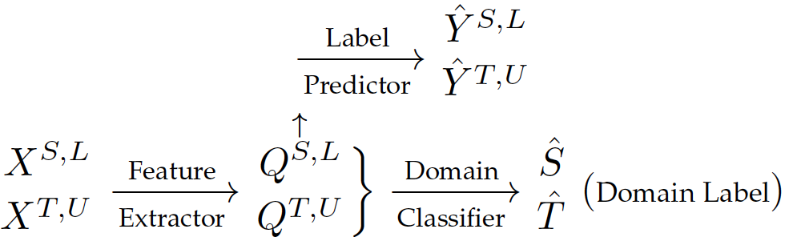
Model Based Interpretation
Adversarial Deep Learning
Many TL approaches, motivated by GAN, aassumes that a good feature representation contains almost no discriminative information about the instance’s original domain
Deep Adversarial Neural Network (DANN)
Assumes no labeled target instances
Architecture consists of:
feature extractor: acts like generator
label predictor: label prediction of the instances
domain classifier: acts like discriminator

Slide 44
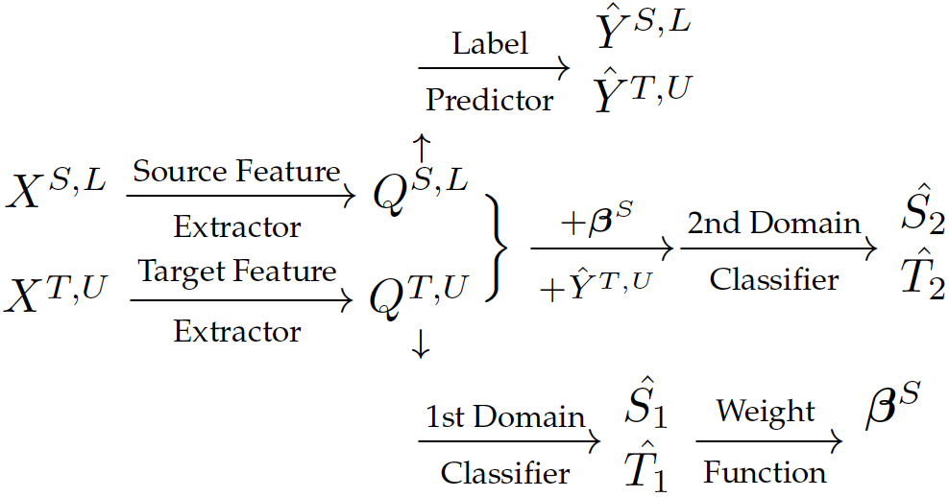
Model Based Interpretation
Adversarial Deep Learning
Conditional Domain Adversarial Network (CDAN)
utilizes conditional domain discriminator to assist adversarial adaptation
Importance Weighted Adversarial Nets-Based Domain Adaptation (IWANDA)
2-domain-specific feature extractors for source and target domains
2-domain classifiers but only 1 label predictor

Slide 45
Application
Medical
ML and computer aided diagnosis for medical imaging
BioInformatics
Understanding of some organisms can be transferred to other organisms
Transportation
Understanding Traffic Image Scenes that suffers from variations due to weather and light conditions
Recommender System
Helps in cases where data is sparse (e.g. when data doesn’t exist for new users)
Communication
Urban Computing
help deal with data scarcity on traffic monitoring, health care, social security, etc
Notes:
Application
Transfer Learning for text analysis and image analysis is playing an important role in the following areas:
Medical Application
Medical Imaging: ML and computer aided diagnosis
Labeling often relies on experienced doctors
Makes it harder to collect sufficient training data
Maqsood et al. finetunes AlexNet for the detection of Alzheimer
Shin et al. finetuned pretrained deep neural network for solving computer aided detection
Byra et al. utilized transfer learning to help assess knee osteoarthritis
Tang et al. combines the active learning and the domain adaptation technologies for the classification of various medical data
Zeng et al. utilizes transfer learning for automatically encoding ICD-9 codes that are used to describe patient diagnosis
Bioinformatics Application
Biological Sequence Analysis: Understanding of some organisms can be transferred to other organisms
Transfer Learning can be applied to facilitate this task
Function of some biological substances may remain unchanged but with the composition changed between two organisms, may result in the marginal distribution difference
Schweikart et al. uses mRNA splice site prediction problem to analyze the effectiveness of transfer learning with promising results.
Gene Expression Analysis: Predicting association between genes and phenotypes
Suffers from data sparsity – Transfer Learning can come to rescue
Petegrosso et al. proposed Label Propagation Algorithm (LPA) based approach to anylyze and predict the gene-phenotype
Xue et al. proposes collective matrix factorization technique to transfer the linkage knowledge from the source Protein-Protein Interaction (PPI) network to the target network
Transportation Application
Understanding Traffic Image Scenes: Suffer from variations due to weather and light conditions
Di et al. proposes and approach to transfer the information of the images of the same location taken in different conditions
Driver Behavior Modeling: Sufficient personalized data of each driver is usually unavailable
Lu et al. proposes an approach to driver model adaptation in lane changing scenarios
Liu et al. applied transfer learning to driver poses recognition
Wang et al. adopted the regularization technique for vehicle type recognition
TL can also be used for anomalous activity detection and traffic sign recognition
Recommender-System Application
Effectively recommending personalized content is an important issue: Traditional method rely on user-item interaction matrix
Requires large amount of data; data is however sparse and doesn’t even exist for new users
Instance and feature based approaches can come for rescue
Pan et al. leverage uncertain ratings from source domain as constraints to complete rating matrix factorization for target domain
Hu et al. uses transfer meeting hybrid to extract knowledge from unstructured text by using attentive memory network and selectively transferring useful information
Pan et al. uses Coordinate System Transfer (CST) to leverage user side and item side latent features
He et al. proposes TL framework based on Bayesian neural network
Communication Application
WiFi localization task and wireless-network applications
Energy saving scheme for cellular radio access networks
Topology management for reducing energy consumption
Urban-Computing Application
Urban computing is a promising research area focusing on traffic monitoring, health care, social security, etc.: TL can help deal with data scarcity
Guo et al. proposes a chain store site recommendation leveraging knowledge from semantically relevant domains (i.e. other cities with same store, other stores in the same city)
Wei et al. proposes a multi-modal TL to transfer knowledge from city with sufficient data and labels to city with sparse data
Hand Gesture Recognition, Face Recognition, Activity Recognition, and Speech Emotion Recognition
Sentiment Analysis, Fraud Detection, Social Network Analysis, and Hyperspectral Image Analysis

Slide 46
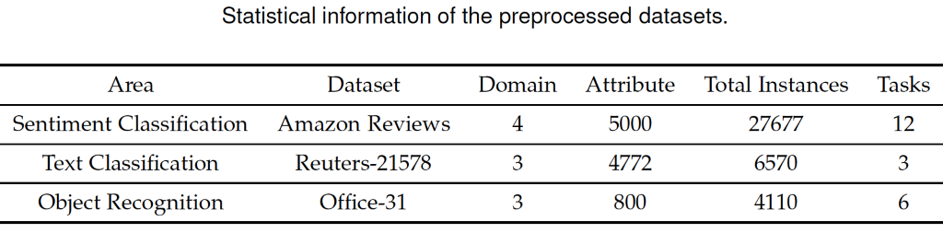
Experiment
2 mainstream research areas:
Object Recognition
Text Classification
Dataset & PreProcessing:
Amazon Reviews: Multi-domain sentiment dataset from Amazon.com in 4 domains (Books, Kitchen, Electronics, and DVD’s)
Reuters-21578 : Text categorization dataset with hierarchical structure
Office-31: Object recognition dataset with 31 categories and 3 domains (Amazon, Webcam, DSLR)
Notes:
Experiment
Experiments are conducted to evaluate some Representative Transfer Learning models across two mainstream research areas:
Object Recognition
Text Classification
Dataset and Preprocessing
Three different datasets have been studied in these experiments.
Amazon Reviews
Multi-domain sentiment dataset from Amazon.com
Four domains: Books, Kitchen, Electronics, and DVD’s
Reviews with rating from 0 to 5 with 0 to 2 defined as negative and 3 to 5 defined as positive
5K words with highest frequency are selected as attributes of each review
1K positive, 1K negative and 5K unlabeled instances in each domain
Every 2 of the 4 domains are selected to generate 12 tasks
Reuters-21578
Text categorization dataset with hierarchical structure
5 top categories – Exchanges, Orgs, People, Places, Topics
3 categories used, Orgs, People, Places – 2 categories are selected at a time across 6 tasks
Each domain has 1K instances and 4.5K features
All instances have label so for unlabeled data labels were ignored
Office-31
Object recognition dataset with 31 categories and 3 domains (Amazon, Webcam, DSLR)
2817, 498 and 795 instances across 3 domains respectively
2 domains are selected at a time resulting in 6 tasks

Slide 47
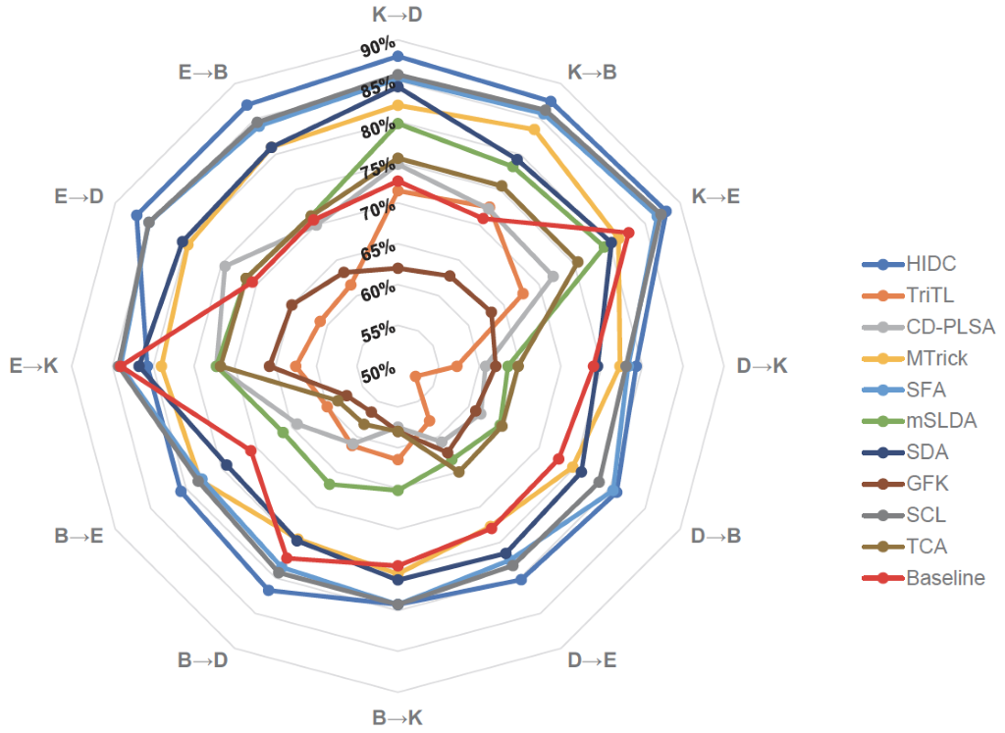
Experiment Result (Amazon Reviews)
Most algorithms performed relatively well when the source domain is electronics / kitchen
These domains may contain more transferable information
Performed relatively well in all 12 tasks
HIDC (feature reduction – clustering)
SCL (feature selection)
SFA (feature alignment)
MTrick (feature reduction – clustering)
SDA (feature encoding)

Slide 48
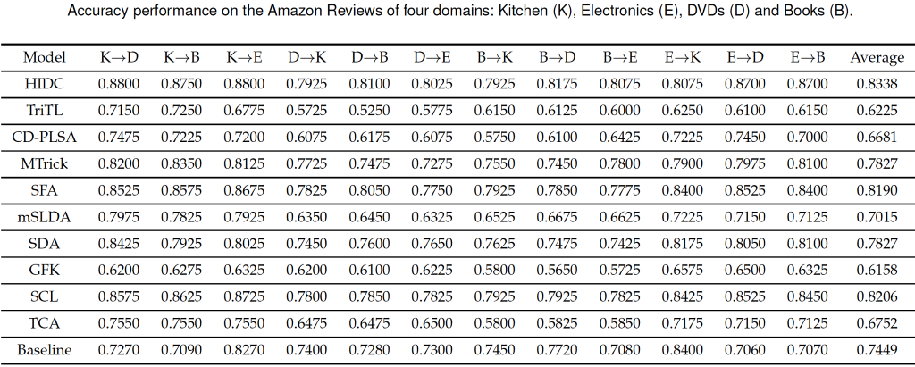
Experiment Result (Amazon Reviews)

Slide 49
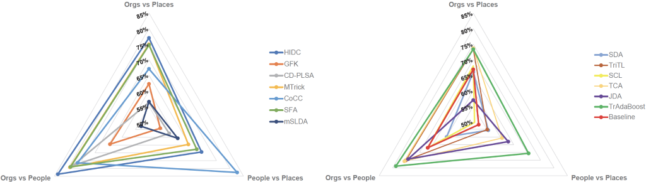
Experiment Result (Reuters-21578 )
Most algorithms performed relatively well for Orgs vs People and Orgs vs Places but poor for People vs Places
Consistent Performance across 3 tasks: HIDC, SFA, MTrick
Top Performers for People vs Places: TrAdaBoost, CoCC

Slide 50
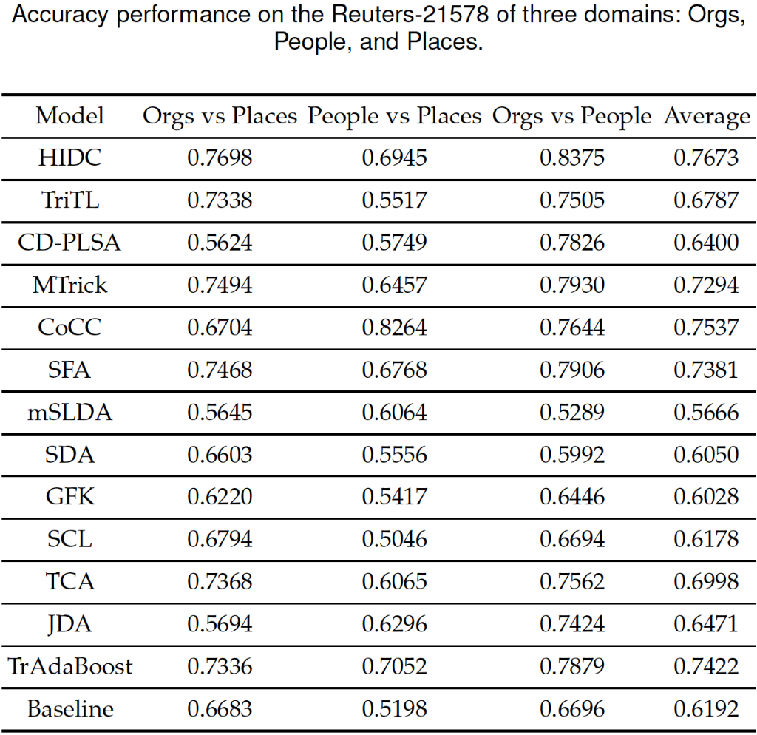
Experiment Result (Reuters-21578 )

Slide 51
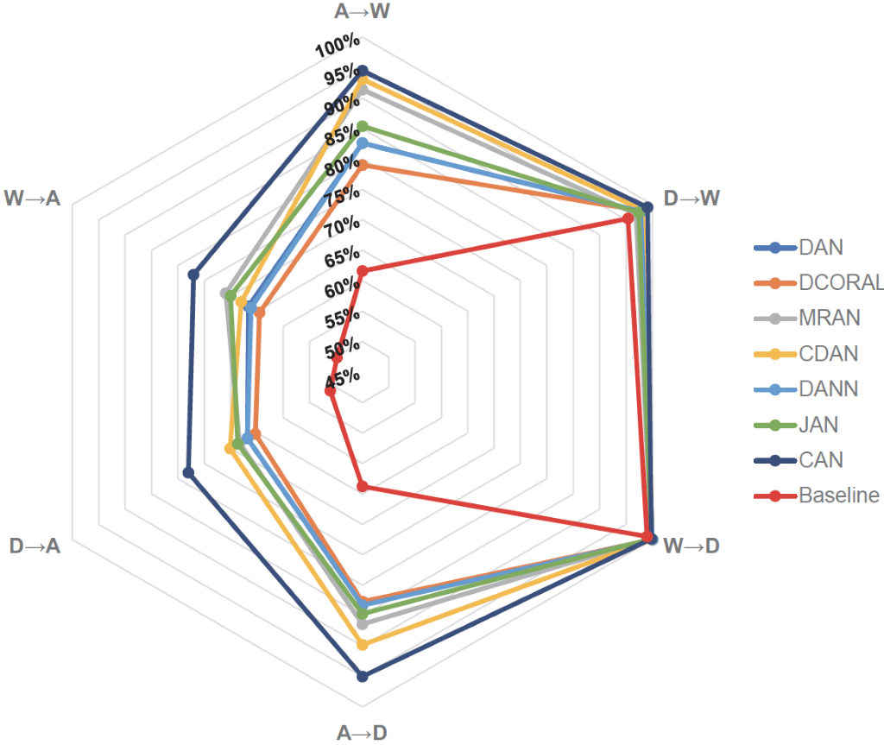
Experiment Result (Office-31 )
All 7 algorithms have excellent performance on tasks D-> W and W->D
Consistent with the fact that WebCam and DSLR are more similar to each other than Amazon
CAN outperforms other 6 algorithms and
DAN and DANN do a good job as well
Adversarial learning is effective

Slide 52
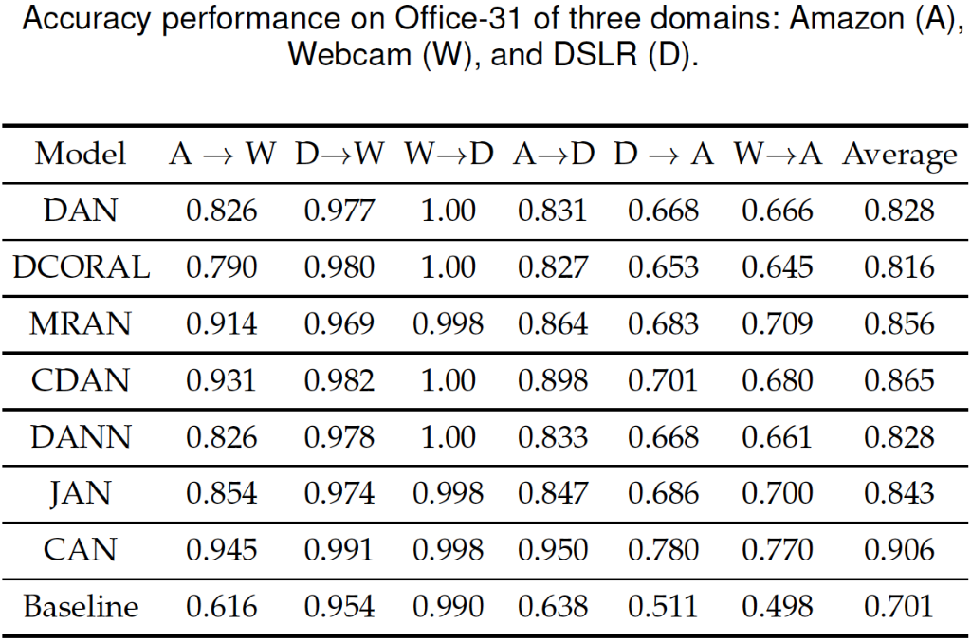
Experiment Result (Office-31 )

Slide 53
Conclusion
Performance of some algorithms is less than ideal
Parameters selected may not be suitable for the datasets
Suitability of algorithms is likely domain dependent
Selection of Transfer Learning model is a complex issue and an important research topic

Slide 54
Future Areas of Exploration
Application of transfer learning to wider range of applications
User privacy protection
How to avoid negative transfers?
Measuring transferability across domains
Interpretability of transfer learning
Theoretical support for transfer learning
Heterogenous transfer learning

